Slide 1
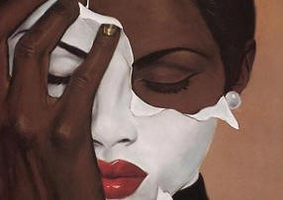
DOUBLE CONSCIOUSNESS
BY YOUNIS ALZUBEIRI

Slide 2
WEARY BLUES
Droning a drowsy syncopated tune,
Rocking back and forth to a mellow croon,
I heard a Negro play.
Down on Lenox Avenue the other night
By the pale dull pallor of an old gas light
He did a lazy sway. . . .
He did a lazy sway. . . .
To the tune o’ those Weary Blues.
With his ebony hands on each ivory key
He made that poor piano moan with melody.
O Blues!
Swaying to and fro on his rickety stool
He played that sad raggy tune like a musical fool.
Sweet Blues!
Coming from a black man’s soul.
O Blues!
In a deep song voice with a melancholy tone
I heard that Negro sing, that old piano moan—
“Ain’t got nobody in all this world,
Ain’t got nobody but ma self.
I’s gwine to quit ma frownin’
And put ma troubles on the shelf.”
Thump, thump, thump, went his foot on the floor.
He played a few chords then he sang some more—
“I got the Weary Blues
And I can’t be satisfied.
Got the Weary Blues
And can’t be satisfied—
I ain’t happy no mo’
And I wish that I had died.”
And far into the night he crooned that tune.
The stars went out and so did the moon.
The singer stopped playing and went to bed
While the Weary Blues echoed through his head.
He slept like a rock or a man that’s dead.
BY LANGSTON HUGHES

Slide 3
ANALYSIS
For some context, the 1920s of American history is primarily known as the Jazz Age. This Age in which African culture was at an all time high and flourishing. A sect of this age is the development of literature, especially poetry. Throughout all this, the question remains, should an African American artist associate its African roots, with their art that is consumed by not only Black people, but white people too. Langston Hughes, who I mentioned in the previous paragraph remains loyal to his culture. A question that is focused upon in the poem is if he is able to overcome the "double consciousness" and take a chance with portraying his African roots in his work. And he answers that question. “I's gwine to quit ma frownin' And put ma troubles on the shelf." Whatever troubles he deals with being an African American, he has to “put it on the shelf” and move on. Because as a Black man in America you can’t have feelings. You can’t deal with it or else you’ll be ridiculed and called over dramatic.

Slide 4
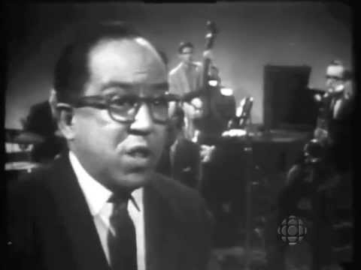
WEARY BLUES
performance

Slide 5
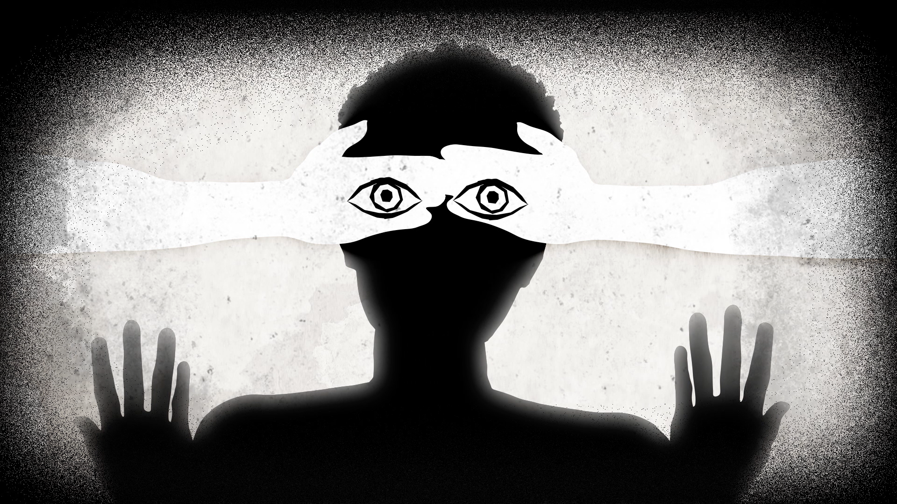
Place your screenshot here
This piece of art was made by The Atlantic for their short animation “How Does It Feel To Be A Problem?” It shows a black person's’ eyes being covered by white hands. This is reminiscent of how censored and concealed Black people have to keep their
identity. They see the world as they were born to,
but adapt to see it through the lens of a white person. And how a white person would react seeing them do normal things. It is a cruel way to live life. It’s merely living, it’s just existing.
It is a peculiar sensation, this double-consciousness, this sense of always looking at one’s self through the eyes of others, of measuring one’s soul by the tape of a world that looks on in amused contempt and pity,” (Gomez 175).

